Slide 1
What is LILO?
LILO stands for Linux Loader which is a bootstrap program.
It is used to load Linux into the memory and start the Operating system.
LILO can be configured to boot other operating systems as well.
LILO is customizable, which means that if the default
configuration is not correct, it can be changed.
Config file for LILO is lilo.conf.

Slide 2
What is LILO?
LILO is a code snippet which loads PC BIOS into the main memory at the time of starting the computer system.
LILO handles the following tasks:
-Locating Linux kernel
-Identifying other supporting programs and loading them in the memory
-Staring Kernel
The selection of various kernel images and boot routines is supported by LILO.
For this reason, LILO is known as boot manager.

Slide 3
What is the use of boot LOader in LInux?
For Linux, the two most common boot loaders are known as LILO (LInux LOader) and LOADLIN (LOAD LINux).
An alternative boot loader, called GRUB (GRand Unified Bootloader), is used with Red Hat Linux. LILO is the most popular boot loader among computer users that employ Linux as the main, or only, operating system.

Slide 4
What is meant by LInux LOader?
LILO (LInux LOader) is a boot loader for Linux and was the default boot loader for most Linux distributions in the years after the popularity of loadlin.
Today, many distributions use GRUB as the default boot loader, but LILO and its variant ELILO are still in wide use.

Slide 5
What is Lilo and Grub?
LILO (Linux Loader) and GRUB (GRand Unified Bootloader) are both configured as a primary boot loader (installed on the MBR) or secondary boot loader (installed onto a bootable partition).
Both work with supporting operating systems such as Linux, FreeBSD, Net BSD, and OpenBSD.

Slide 6
What is the use of grub in Linux?
GRUB is a boot loader designed to boot a wide range of operating systems from a wide range of file systems.
GRUB is becoming popular due to the increasing number of possible root file systems that can Linux can reside upon.
GRUB is documented in a GNU info file.

Slide 7
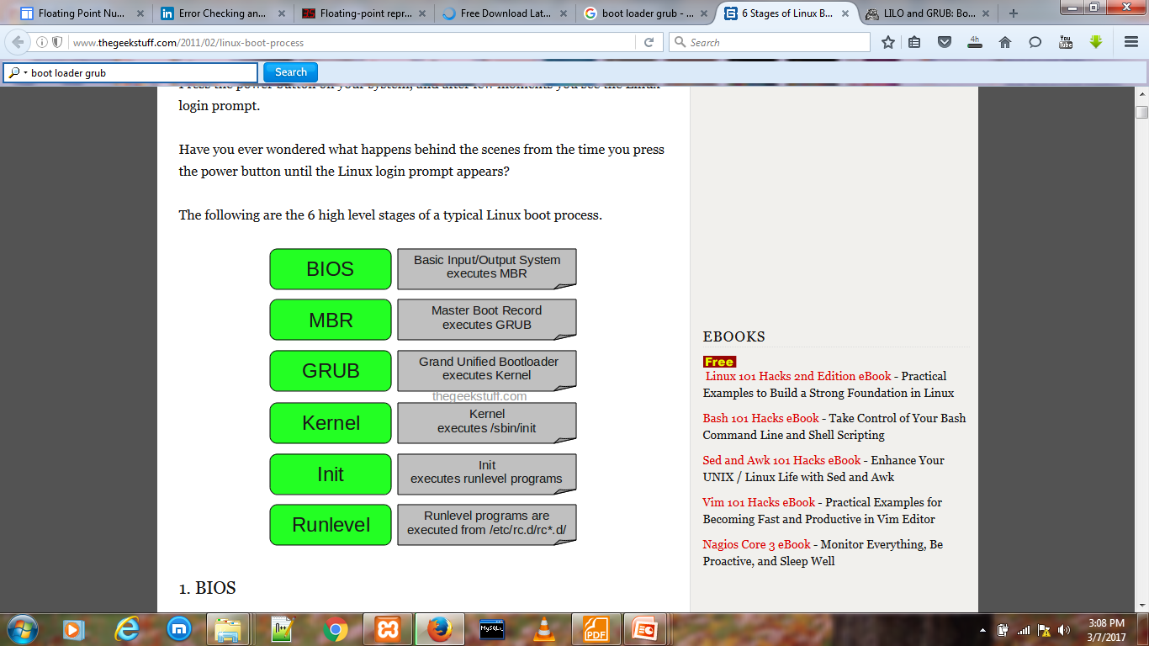

Slide 8
6 Stages of Linux Boot Process
1. BIOS
BIOS stands for Basic Input / Output System Performs some system integrity checks Searches, loads, and executes the boot loader program.
It looks for boot loader in floppy, cd-rom, or hard drive. You can press a key (typically F12 of F2, but it depends on your system) during the BIOS startup to change the boot sequence.
Once the boot loader program is detected and loaded into the memory, BIOS gives the control to it.
So, in simple terms BIOS loads and executes the MBR boot loader.

Slide 9
6 Stages of Linux Boot Process
2. MBR
MBR stands for Master Boot Record.
It is located in the 1st sector of the bootable disk. Typically /dev/hda, or /dev/sda
MBR is less than 512 bytes in size. This has three components 1) primary boot loader info in 1st 446 bytes 2) partition table info in next 64 bytes 3) mbr validation check in last 2 bytes.
It contains information about GRUB (or LILO in old systems).
So, in simple terms MBR loads and executes the GRUB boot loader.

Slide 10
6 Stages of Linux Boot Process
3. GRUB
GRUB stands for Grand Unified Bootloader.
If you have multiple kernel images installed on your system, you can choose which one to be executed.
GRUB displays a splash screen, waits for few seconds, if you don’t enter anything, it loads the default kernel image as specified in the grub configuration file.
GRUB has the knowledge of the filesystem
Grub configuration file is /boot/grub/grub.conf (/etc/grub.conf is a link to this). The following is sample grub.conf of CentOS.

Slide 11
6 Stages of Linux Boot Process
4. Kernel
Mounts the root file system as specified in the “root=” in grub.conf
Kernel executes the /sbin/init program
Since init was the 1st program to be executed by Linux Kernel, it has the process id (PID) of 1. Do a ‘ps -ef | grep init’ and check the pid.
initrd stands for Initial RAM Disk.
initrd is used by kernel as temporary root file system until kernel is booted and the real root file system is mounted. It also contains necessary drivers compiled inside, which helps it to access the hard drive partitions, and other hardware.

Slide 12
6 Stages of Linux Boot Process
5. Init
Looks at the /etc/inittab file to decide the Linux run level.
Following are the available run levels
  0 – halt
  1 – Single user mode
  2 – Multiuser, without NFS
  3 – Full multiuser mode
  4 – unused
  5 – X11
  6 – reboot
Init identifies the default initlevel from /etc/inittab and uses that to load all appropriate program.
Execute ‘grep initdefault /etc/inittab’ on your system to identify the default run level
If you want to get into trouble, you can set the default run level to 0 or 6. Since you know what 0 and 6 means, probably you might not do that.
Typically you would set the default run level to either 3 or 5.

Slide 13
6 Stages of Linux Boot Process
6. Runlevel programs
When the Linux system is booting up, you might see various services getting started. For example, it might say “starting sendmail …. OK”. Those are the runlevel programs, executed from the run level directory as defined by your run level.
Depending on your default init level setting, the system will execute the programs from one of the following directories.
  Run level 0 – /etc/rc.d/rc0.d/
  Run level 1 – /etc/rc.d/rc1.d/
  Run level 2 – /etc/rc.d/rc2.d/
  Run level 3 – /etc/rc.d/rc3.d/
  Run level 4 – /etc/rc.d/rc4.d/
  Run level 5 – /etc/rc.d/rc5.d/
  Run level 6 – /etc/rc.d/rc6.d/

Slide 14
6 Stages of Linux Boot Process
Please note that there are also symbolic links available for these directory under /etc directly. So, /etc/rc0.d is linked to /etc/rc.d/rc0.d.
Under the /etc/rc.d/rc*.d/ directories, you would see programs that start with S and K.
Programs starts with S are used during startup. S for startup.
Programs starts with K are used during shutdown. K for kill.
There are numbers right next to S and K in the program names. Those are the sequence number in which the programs should be started or killed.
For example, S12syslog is to start the syslog deamon, which has the sequence number of 12. S80sendmail is to start the sendmail daemon, which has the sequence number of 80. So, syslog program will be started before sendmail.

